Slide 1

Takenmind Global Data Analytics Internship
PROOF OF CONCEPT
ATTRITION CONTROL PROJECT

Slide 2

Project Context
Objective
Solution Methodology stepwise
Finding and analysis

Slide 3

Objectives:
The data is for company X which is trying to control attrition. There are two sets of data: “Existing employees” and “Employees who have left”.
Objective of the project is to find out:
What type of employees are leaving?
Which employee are prone to leave next?

Slide 4
Step 1:
At first step , we need to understand the dataset for both employee who left and existing employee.
It is very important to analysis all the features in dataset and observe which features has upper hand in cause for employee to leave company.

Slide 5
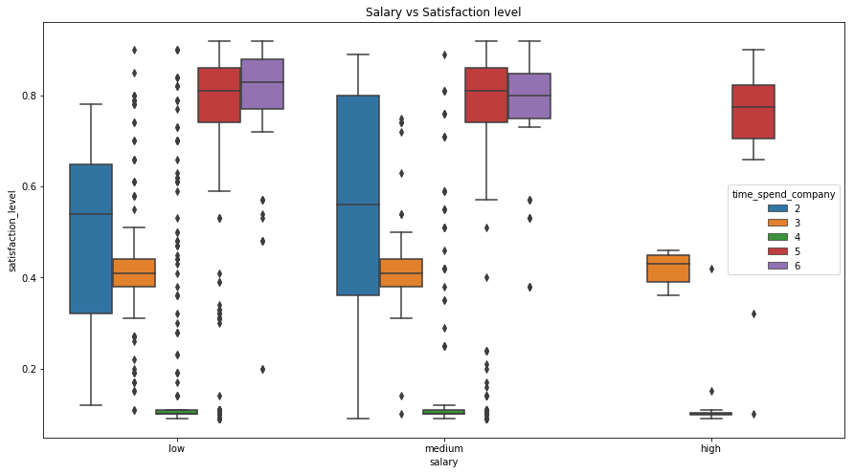
Step 2:
Point drawn from above plot:
Average monthly hours is very low for employees who has number of projects equal to 2 for all levels of salary.
As we can see from the plot the employees from all levels for salary are loaded with projects and monthly hours is high.
We can see there are so many outliers from low and medium salary levels. The box plot is bigger for low salary employees who has number of projects equal to 3, 50% of these employees high monthly hours

Slide 6
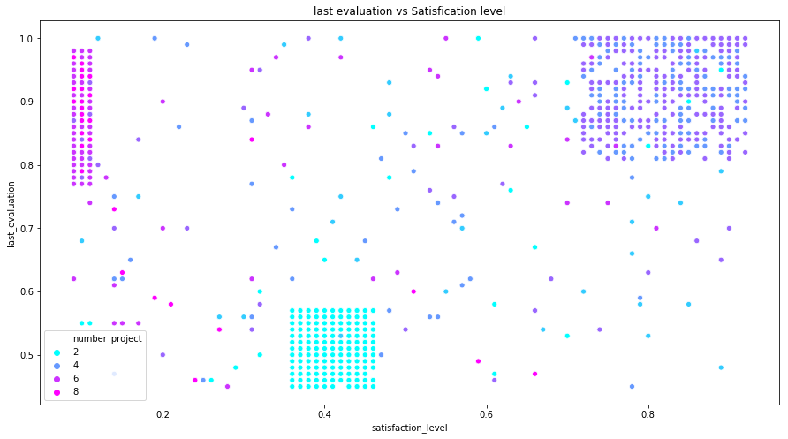
Satisfaction level is high for less no of projects( i.e. projects that are 4 or less than 4).
As the no of projects increases the satisfaction level decreased in the dataset of employee who left the company.

Slide 7
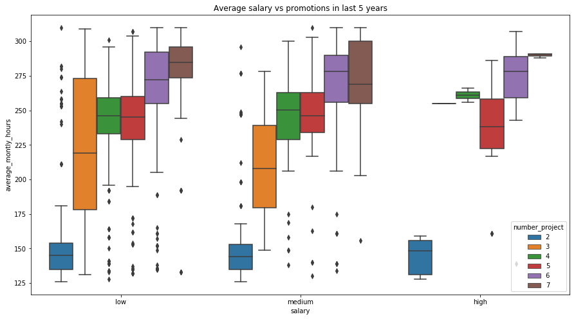
From the above figure we can get following information:
1. Very few employee had high salary.
2. There were many employee who used to do more projects and spend more monthly hours still have low salary.
3. More no of projects means more monthly hours.

Slide 8
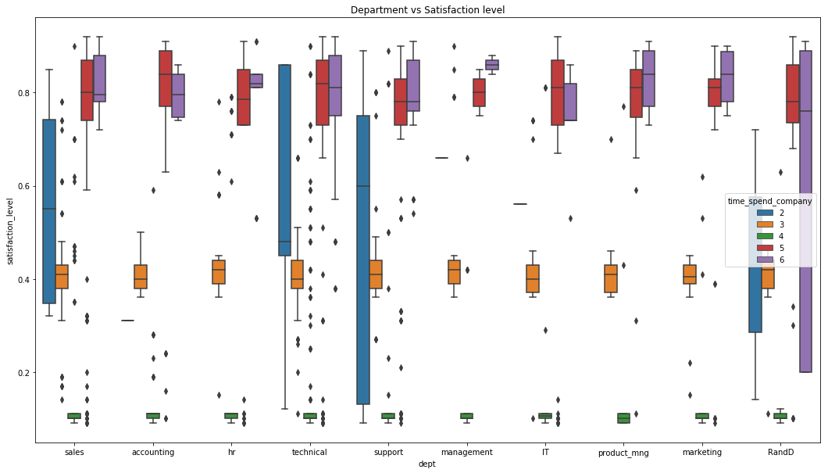
Interesting points we can draw from above plot-
1. Employees from R&D department having 6 years of time spend having large distribution of satisfaction levels.
2. Time spend equal to 4 in all departments are having same level of very low satisfaction levels same goes for time spend equals to 3 having same level of average satisfactions in all departments.

Slide 9
After all these analysis we can predict what were the causes for the employee to leave the company.
Some of the reason are as follows:
1. Employees who are stressed up working more hours and having higher number of projects.
2. Mostly from sales and technical department were leaving the company.
3. the employees are not getting promotion even they are working tirelessly.

Slide 10
Reasons that could prone existing employee to leave:
1. Satisfaction Level below 40%
2. Low salary
3. More Average monthly hours and Number of projects
4. No Promotion in LAST 5 Years.
If any employee satisfies 2 or more than 2 above condition he/she is prone to leave the company

Slide 11

THANK YOU Takenmind for this Internship opportunities
Presented By
Bijay Adhikari

